Slide 1
Food Delivery App For Hometowm Restaurant
Aathidya varman.R
Date: 29 - 06 - 2022

Slide 2
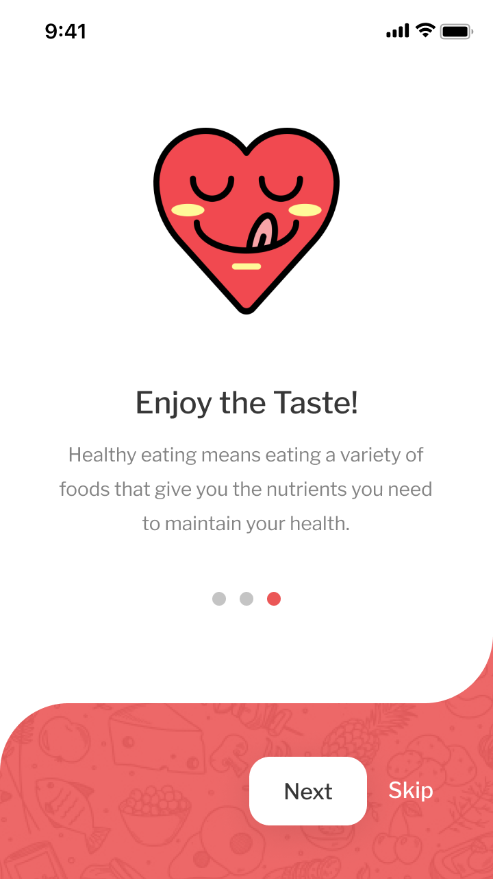
Project overview
Overview
I designed an app that lets you order street-food online.A food delivery app that provides food delivery at your door in very less time and with the best packaging.
Preview of selected polished designs.
Project duration:
March 2022 to June 2022

Slide 3
Project overview
The problem:
Amidst the hustle and bustle of today’s fast-paced environment, individuals struggle to find the time to cook at home. The challenge was to find a way for these individuals to order and receive food at their own convenience.
The goal:
To build a platform where people can find their favorite food and order it at their doorstep online.

Slide 4
Project overview
My role:
Solo Ux Designer
Responsibilities:
Ux Research, UI design, Ux Writing and Usability Studies

Slide 5
User research
Personas
Problem statements
User journey maps
Understanding
the user

Slide 6
User research: summary
Survey, Direct Interviews, Empathy maps, Personas, User journey maps, Competitive Audit

Slide 7
User research: pain points
1
2
3
4
Time
Easy Use
High price
No Time to search
Busy Professionals do not have time to prepare meals on their own
Most food delivery is not Easy to use
Extra delivery charges make cheap street-food expensive.
Not finding enough online street-food options to order from.

Slide 8
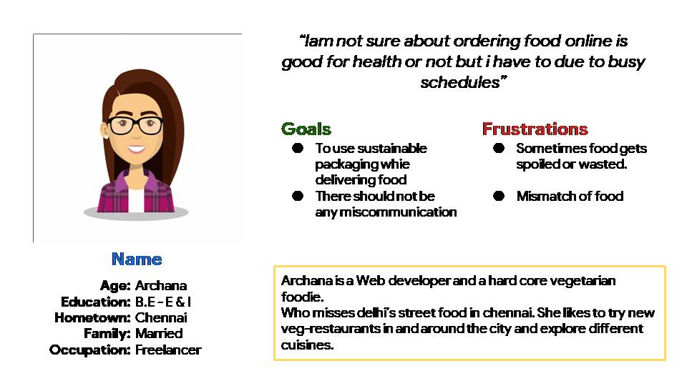
Persona: Name
Problem statement:
Archana is a Freelancing Web developer
who needs to to meet lot of clients
Because of that she order food online more often.

Slide 9
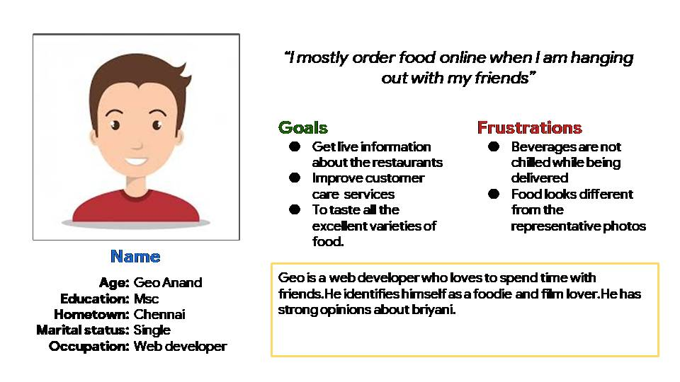
Persona: Name
Problem statement:
Geo Anand is a Web developer
who likesto hang out with friends often
So he loves to order food when he hangs out with friends.

Slide 10
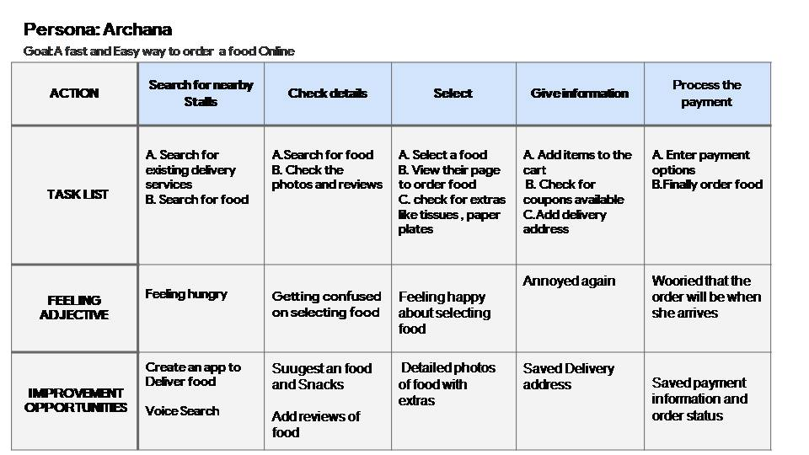
User journey map
Archana needs often orders food when she is out of home
She suggests an detailed photos of food with Extras
Image of user journey map

Slide 11
Digital wireframes
Low-fidelity prototype
Usability studies
Starting
the design

Slide 12
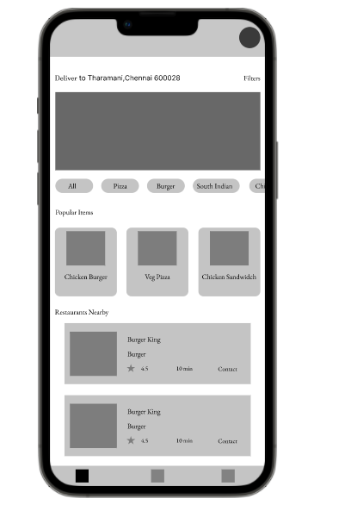
Digital wireframes
Banner Image about Food or Restaurant
[Login screen]
\
List of poplar Items

Slide 13
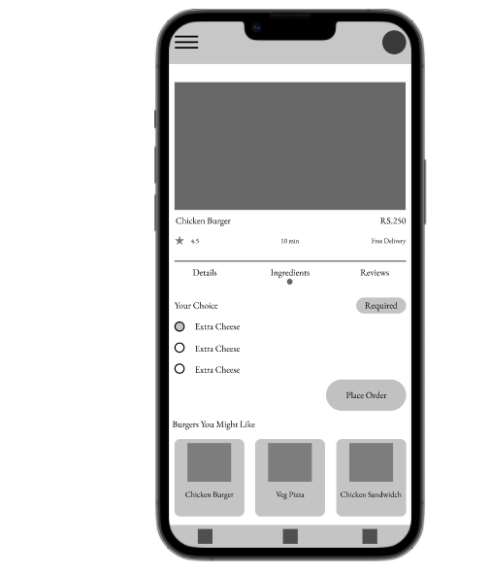
Digital wireframes
Image of the particular food Selected
[Product page]
Addition and Extras Required

Slide 14
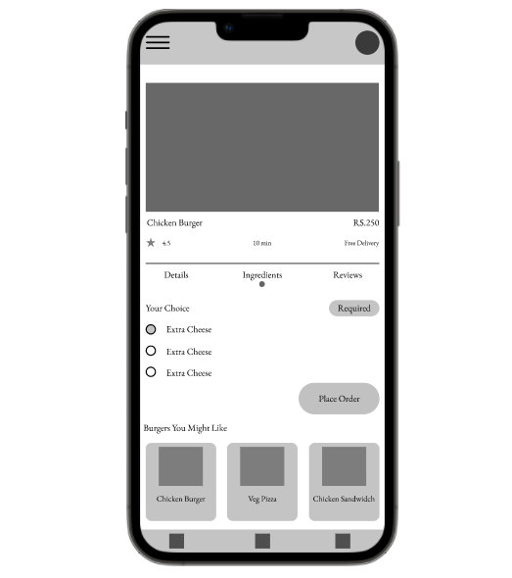
Digital wireframes
[Your notes about goals and thought process]
CTA for place order
Related Products

Slide 15
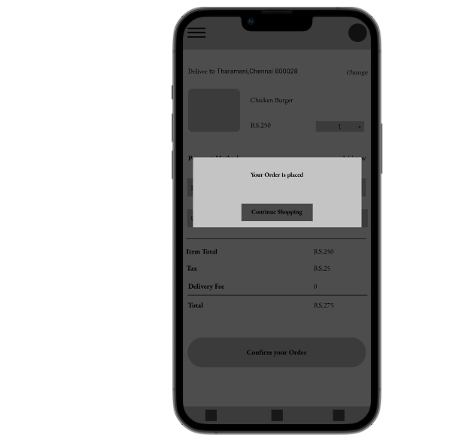
Digital wireframes
[Order confirmed Page]
Order confirmed and Continue Shopping CTA

Slide 16
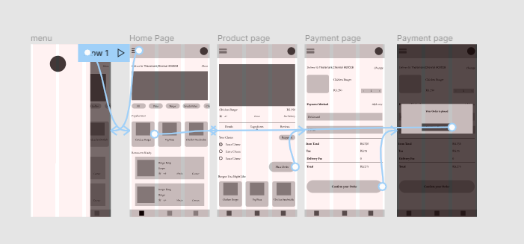
Low-fidelity prototype
[https://www.figma.com/proto/7VqHB6af5lQMKlqe96K7S7/Untitled?page-id=0%3A1&node-id=3%3A2&viewport=253%2C149%2C0.42&scaling=scale-down&starting-point-node-id=3%3A2]
Screenshot of prototype with connections or prototype GIF

Slide 17
Usability study: findings
Write a short introduction to the usability studies you conducted and your findings.
Round 1 findings
1
Participant confused whether to add to cart first or to choose whether pickup & Delivery
2
Participant tries clicking on the hollow checkout payment button before choosing the payment option
Participant thinks it easy and feels good about it
3

Slide 18
Refining
the design
Mockups
High-fidelity prototype
Accessibility

Slide 19
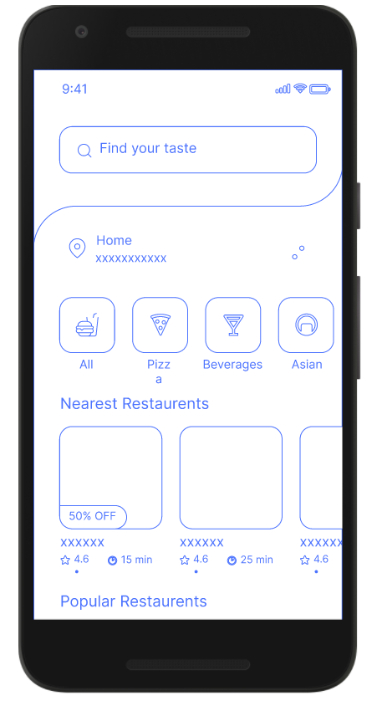
Mockups
Before usability study
After usability study
[Home page
Image of selected screen before usability study
Image of selected screen after usability study

Slide 20
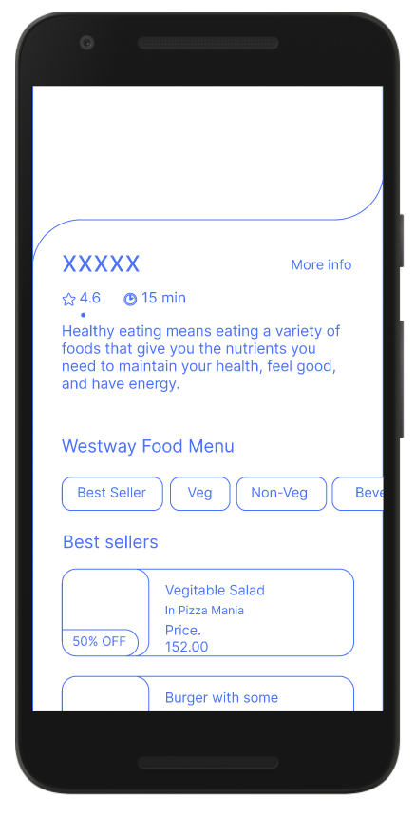
Mockups
Before usability study
After usability study
[restaurant or product page]
Image of selected screen before usability study
Image of selected screen after usability study

Slide 21
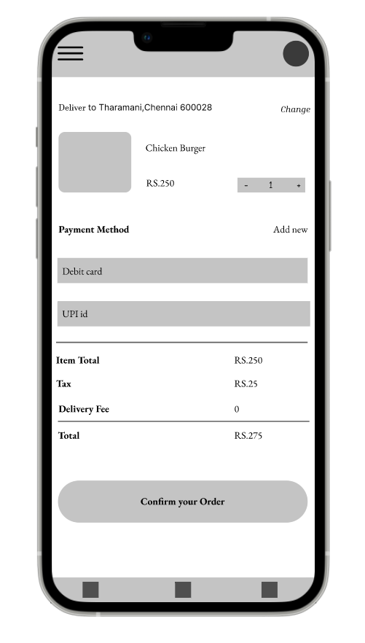
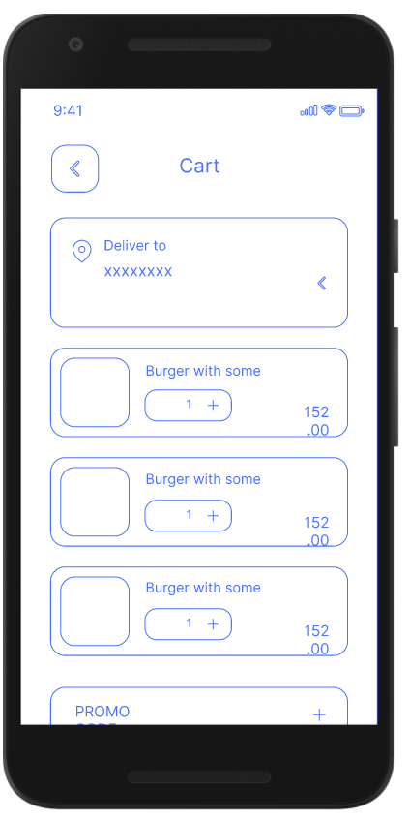
Mockups
Before usability study
After usability study
[cart page]
Image of selected screen before usability study

Slide 22
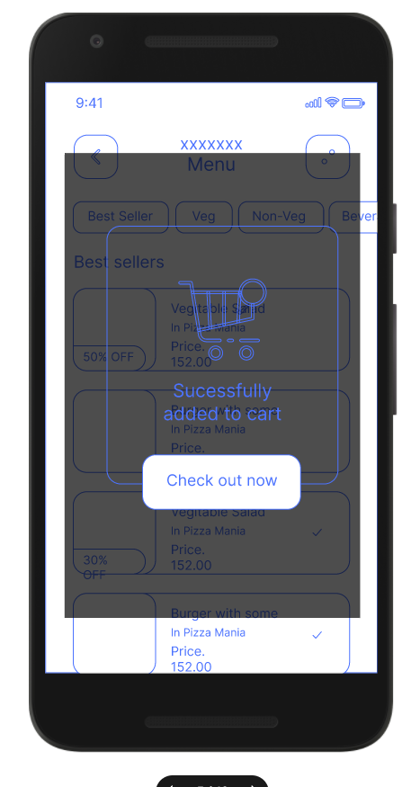
Mockups
Before usability study
After usability study
[Order confirmed]
Image of selected screen before usability study
Image of selected screen after usability study

Slide 23
Usability study: findings
Write a short introduction to the usability studies you conducted and your findings.
Round 1 findings
Round 2 findings
1
Participant confused whether to add to cart first or to choose whether pickup & Delivery
1
Yellow Color is less contrast
2
Participant tries clicking on the hollow checkout payment button before choosing the payment option
2
More times colors used in single page
Participant thinks it easy and feels good about it
3

Slide 24
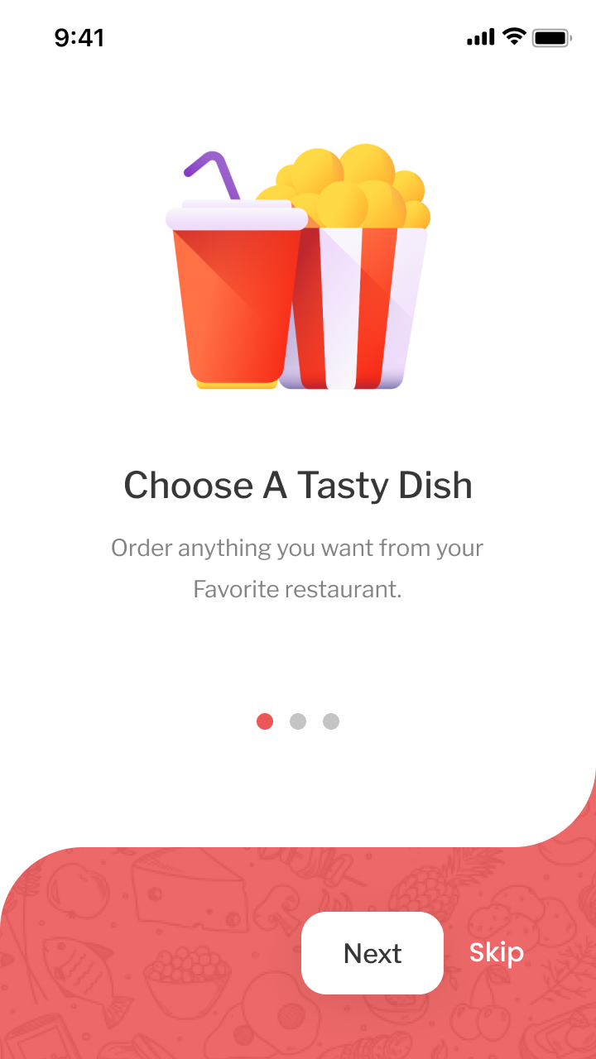
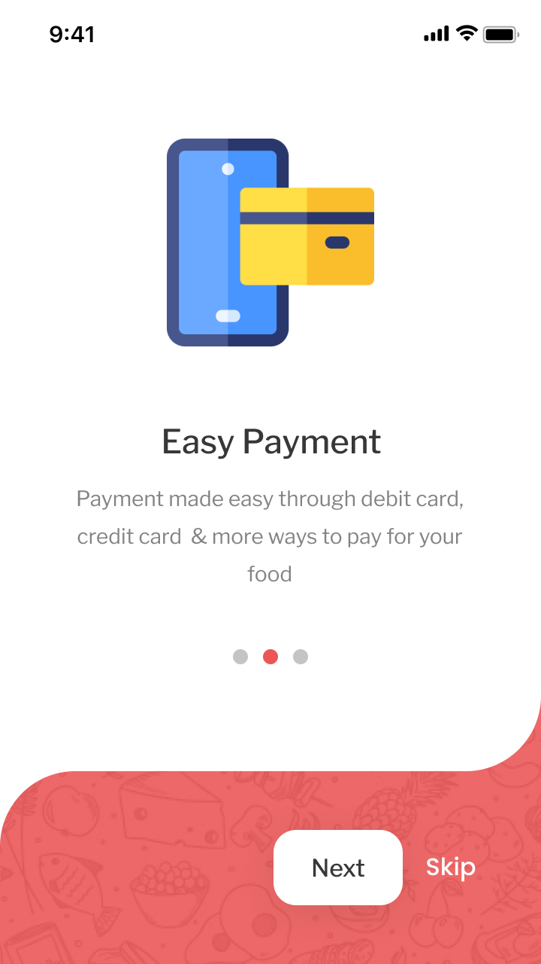
High Fidelity Mockupss
https://www.figma.com/proto/nHDmQCM0LGkpFmlJxx7Qgm/Food-delivery?node-id=4%3A107&scaling=scale-down&page-id=0%3A1&starting-point-node-id=4%3A107

Slide 25
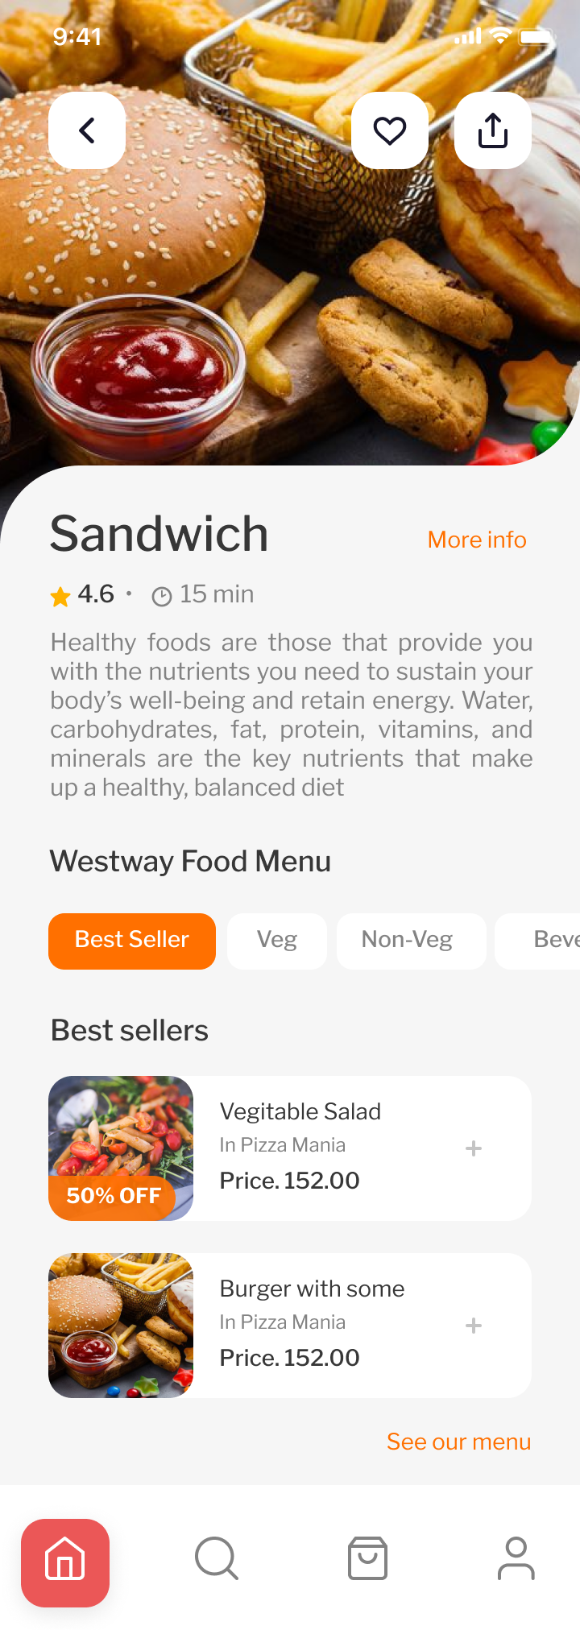
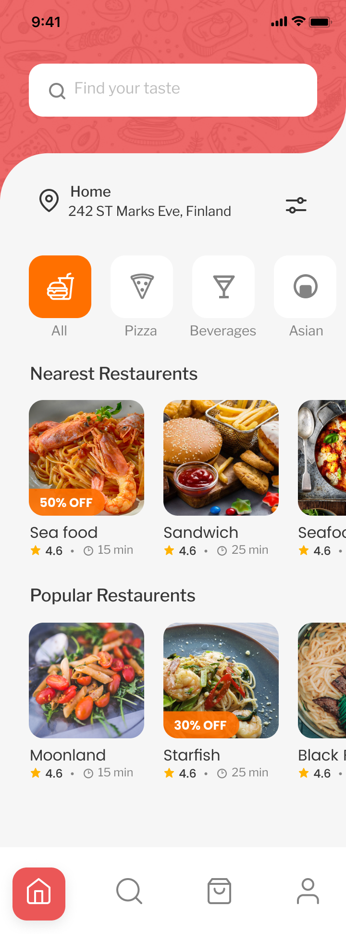
High Fidelity Mockupss
[Home page]
[Product page]

Slide 26
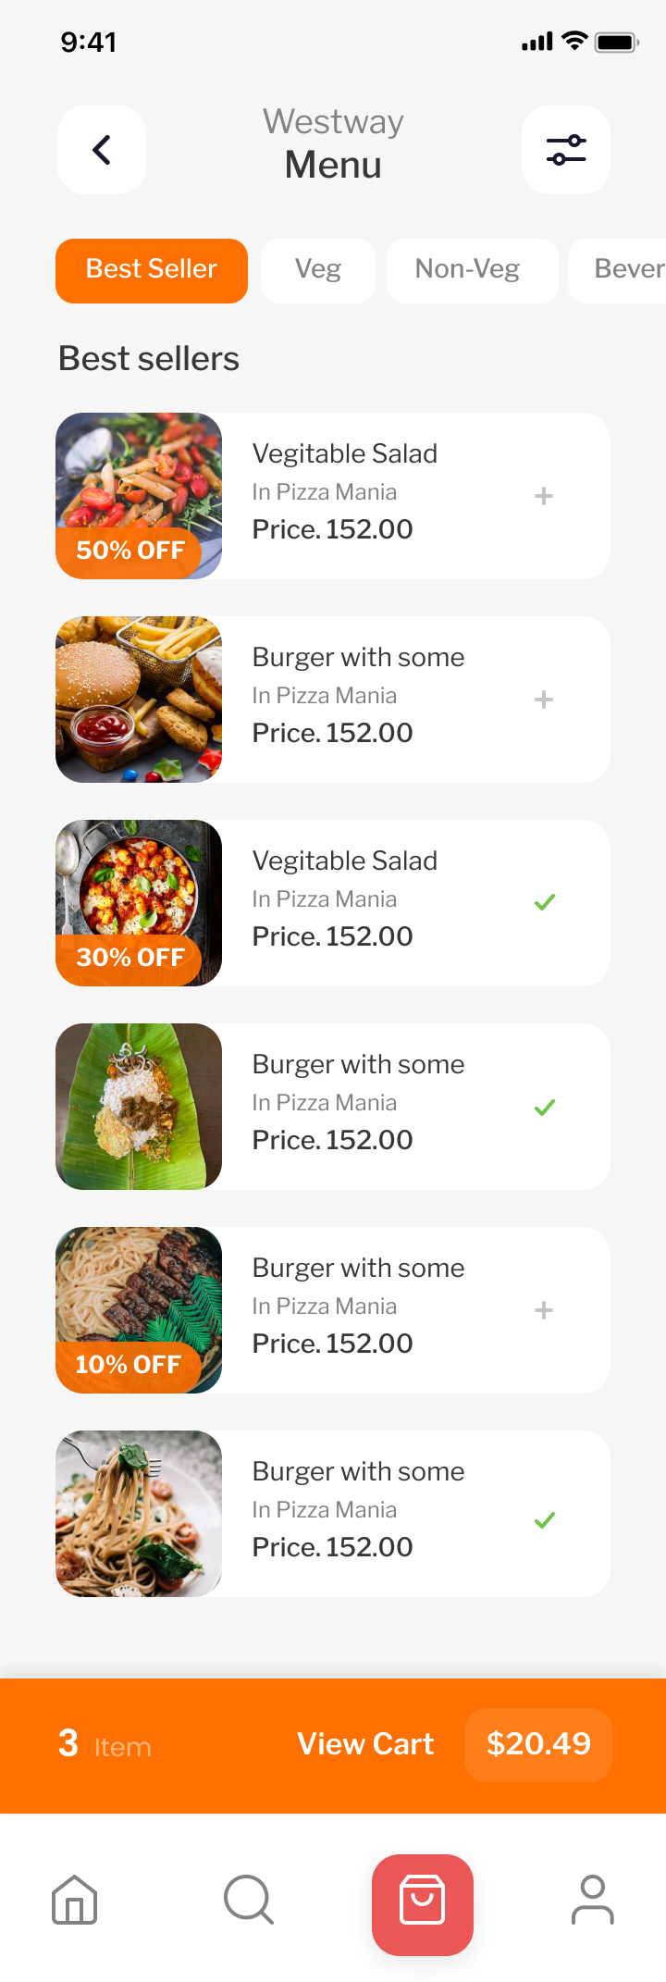
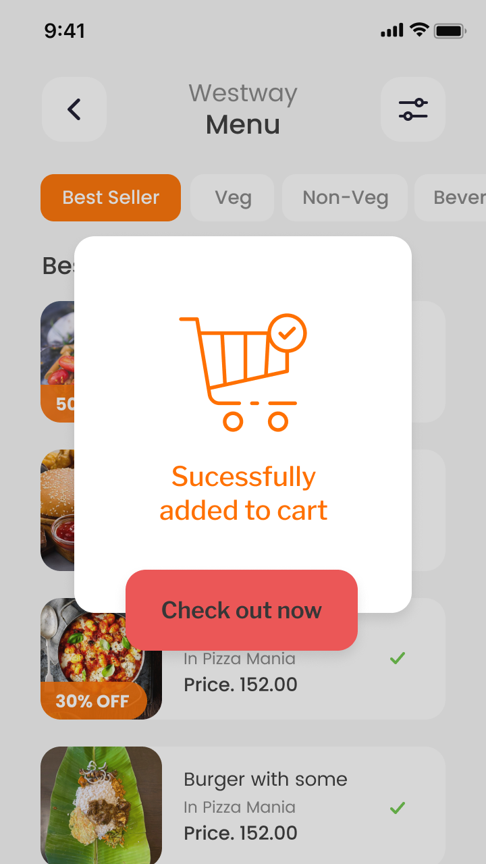
High Fidelity Mockupss
[Menu Items]
[Items added to cart]

Slide 27
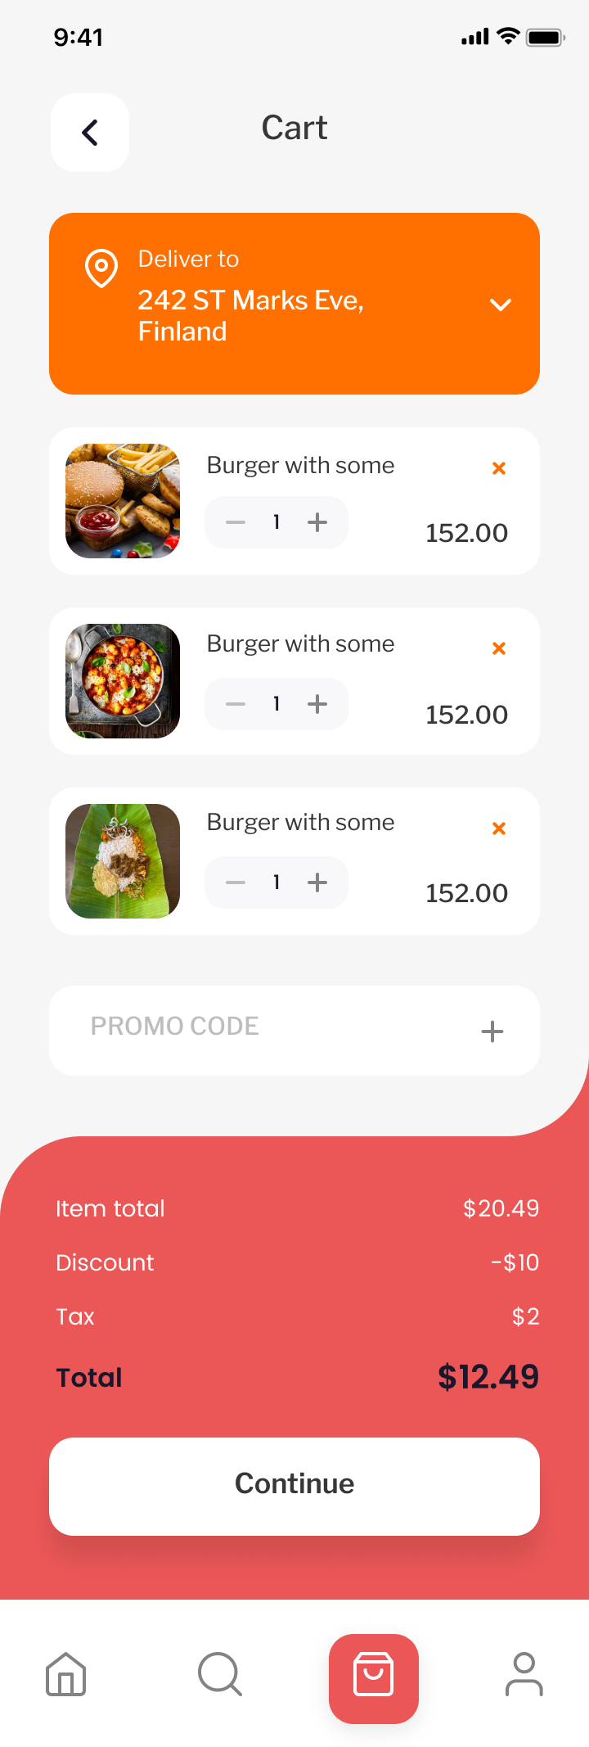
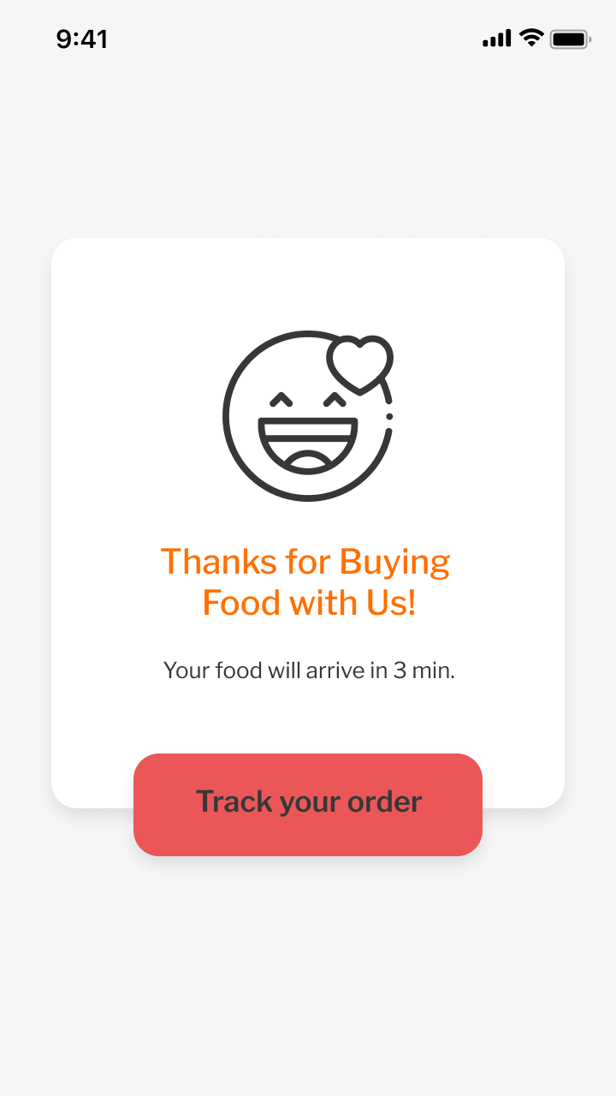
High Fidelity Mockupss
[Cart Page]
[Success Page]

Slide 28
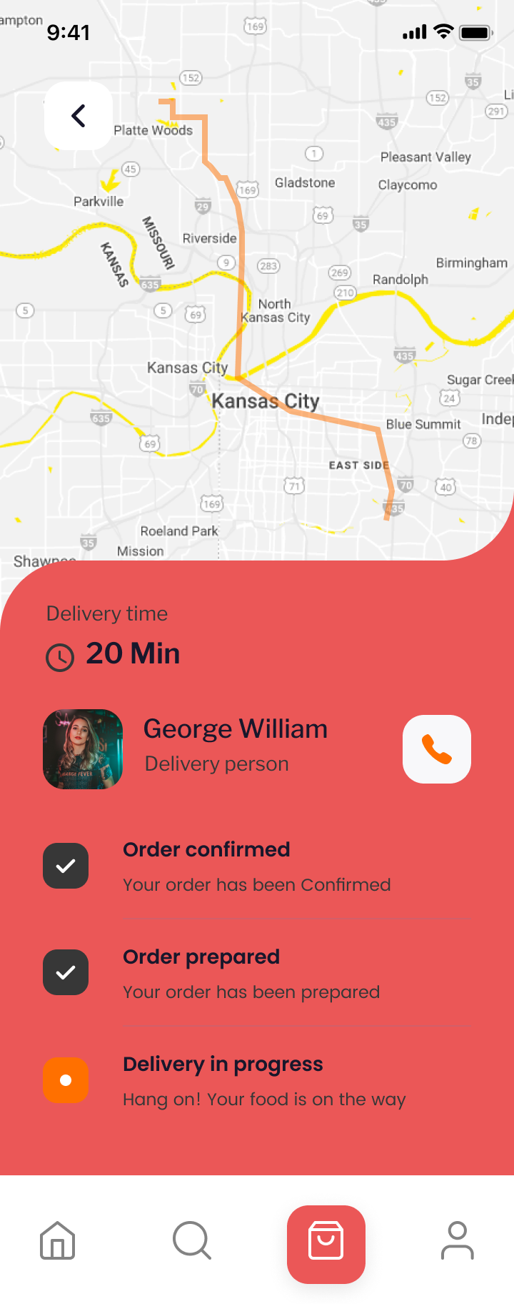
High Fidelity Mockupss
[Order Tracking]

Slide 29
Accessibility
This design is also made for people who didn’t know the english knowledge by using Universal icons to show the action of a CTA

Slide 30
Takeaways and next steps
Testing for final prototype needs to be done
Placeholders should be filled with contents
Fidelity links should be sent to Developer

Slide 31
Next Steps
High Fidelity Mockups
Usability Study for High Fidelity Mockups
Accessibilty Findings
User Testing

Slide 32
Thankyou

